Slide 1
Chapter 3
CREATING AND MANAGING SUPPLIER RELATIONSHIPS

Slide 2
LEARNING OBJECTIVES
You should be able to:
Explain the importance of supplier partnerships
Understand the key factors for developing successful partnerships
Develop a supplier evaluation & certification program
Explain the importance of a supplier recognition program
Understand the capabilities of Supplier Relationship Management
Explain the benefits of using SRM software to manage suppliers
©2012 Cengage Learning. All Rights Reserved. May not be scanned, copied or duplicated, or posted to a publicly accessible website, in whole or in part.

Slide 3
CHAPTER OUTLINE
Introduction
Developing Supplier Relationships
Supplier Evaluation & Certification
Supplier Development
Supplier Recognition Programs
Supplier Relationship Management
©2012 Cengage Learning. All Rights Reserved. May not be scanned, copied or duplicated, or posted to a publicly accessible website, in whole or in part.

Slide 4
Keys to Successful Partnerships
Strong supplier partnerships
  Important to achieving win-win competitive performance for the buyer and supplier -- these require a strategic perspective as opposed to a tactical position
  Involve “a mutual commitment over an extended time to work together to the mutual benefit of both parties, sharing relevant information and the risks and rewards of the relationship”

Slide 5
Keys to Successful Partnerships (Continued)
Building Trust
With trust, partners are more willing to work together, find compromise solutions to problems, work toward achieving long-term benefits for both parties, &, in short, go to the extra mile.
Shared Vision & Objectives
Both partners must share the same vision & have objectives that are not only clear but mutually agreeable. The focus must move beyond tactical issues & toward a more strategic path to corporate success.

Slide 6
Keys to Successful Partnerships (Continued)
Personal Relationships
It is people who communicate & make things happen
Mutual Benefits & Needs
Partnership should result in a win-win situation, which can only be achieved if both companies have compatible needs. An alliance is much like a marriage, & if only one party is happy, then the marriage is not likely to last

Slide 7
Keys to Successful Partnerships (Continued)
Commitment & Top Management Support
Commitment must start at the highest management level. Partnerships tend to be successful when top executives are actively supporting the partnership
Change Management
Companies must be prepared to manage change that comes with the formation of new partnerships

Slide 8
Keys to Successful Partnerships (Continued)
Information Sharing & Lines of Communication
Both formal & informal lines of communication should be set up to facilitate free flow of information. Confidentiality of sensitive information must be maintained
Capabilities
Key suppliers must have the right technology & capabilities to meet cost, quality, & delivery requirements in a timely manner

Slide 9
Keys to Successful Partnerships (Continued)
Performance Metrics
You can’t improve what you can’t measure
Measures related to quality, cost, delivery, & flexibility are used to evaluate suppliers.
Metrics should be:1) understandable, 2) easy to measure, & 3) focused on real value-added results
A multi-criteria approach is best
Total cost of ownership (TCO), is made up of all costs associated w/acquisition, use, & maintenance of a good or service

Slide 10
Keys to Successful Partnerships (Continued)
Continuous Improvement
Making a series of small improvements over time results in the elimination of waste in a system
Buyers & suppliers must be willing to continuously improve their capabilities in meeting customer requirements of cost, quality, delivery, & technology

Slide 11
Supplier Evaluation & Certification
A process to identify best & most reliable suppliers
Sourcing decisions are made on facts & not on perception
Frequent feedback can help avoid surprises & maintain good relationships.
Suppliers should be allowed to provide constructive feedback to the customer
  Supplier Certification refers to “an organization’s process for evaluating the quality systems of key suppliers in an effort to eliminate incoming inspections.” -Institute for Supply Management

Slide 12
Supplier Evaluation & Certification (Continued)
Criteria Used in Certification Programs
No incoming product lot rejections (e.g., less than 0.5 percent defective) for a specified time period.
No incoming non-product rejections (e.g., late delivery) for a specified time period
No significant supplier production-related negative incidents for a specified time period
ISO 9000/Q9000 certified or successfully passing a recent, on-site quality system evaluation
Mutually agreed-upon set of clearly specified quality performance measures
Fully documented process & quality system with cost controls & continuous improvement capabilities
Supplier’s processes stable & in control

Slide 13
Supplier Evaluation & Certification (Continued)
The Weighted-Criteria Evaluation System
Select the key dimensions of performance mutually acceptable to both customer & supplier.
Monitor & collect performance data.
Assign weights to each of the dimensions.
Evaluate performance measures between 0 & 100.
Multiply dimension rating by weight & sum of overall score.
Classify vendors based on their overall score: Unacceptable, Conditional, Certified, & Preferred
Audit & perform ongoing certification review.

Slide 14
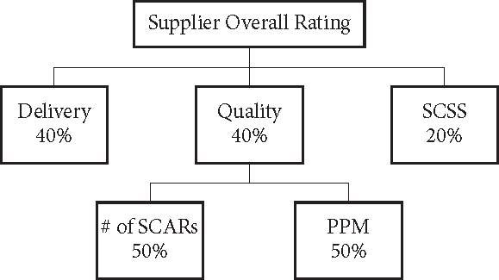
Supplier Evaluation & Certification (Continued)

Slide 15
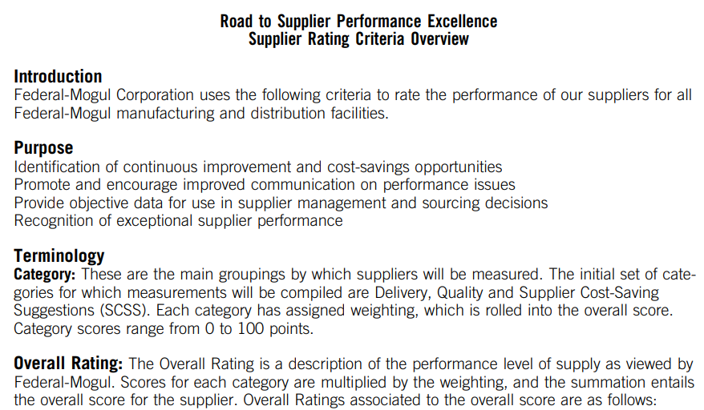
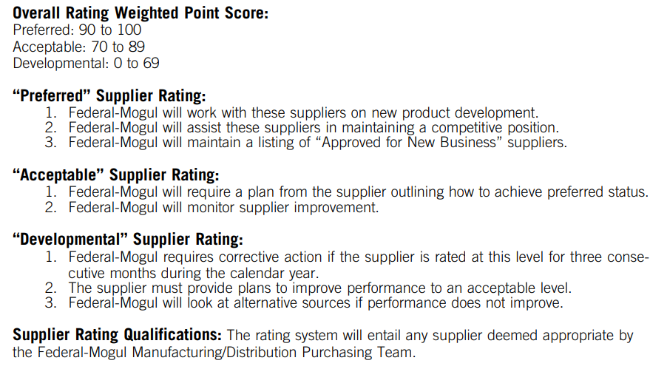

Slide 16
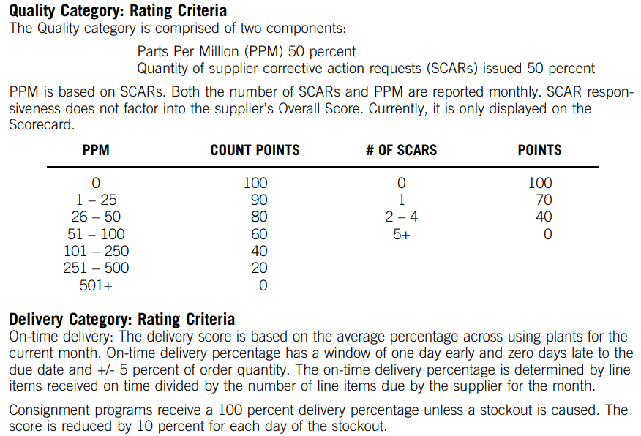

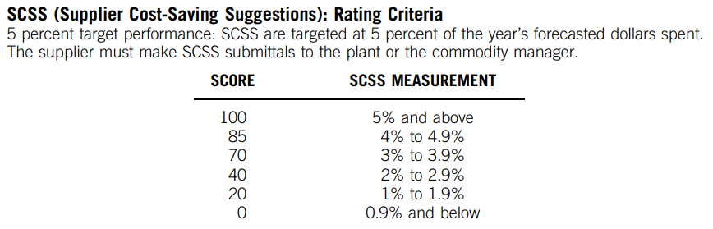
©2012 Cengage Learning. All Rights Reserved. May not be scanned, copied or duplicated, or posted to a publicly accessible website, in whole or in part.

Slide 17
Supplier Evaluation & Certification (Continued)
Supplier Scorecard Used for the XYZ Company
Performance Measure | Rating x Weight = Final Value
Technology | 80 | 0.10 | 8.00
Quality | 90 | 0.25 | 22.50
Responsiveness | 95 | 0.15 | 14.25
Delivery | 90 | 0.15 | 13.50
Cost | 80 | 0.15 | 12.00
Environmental | 90 | 0.05 | 4.50
Business | 90 | 0.15 | 13.50
Total score |  | 1.00 | 88.25
(Table 3.3. )

Slide 18
Supplier Evaluation & Certification (Continued)
ISO 9000
Developed by International Organization for Standardization (ISO) - series of management & quality standards in design, development, production, installation, & service.
Companies wanting to sell in the global market seek ISO 9000 certification.
ISO 14000
A family of standards for environmental management.
The benefits include reduced energy consumption, environmental liability, waste & pollution, & improved community goodwill.

Slide 19
Supplier Development
Supplier development
A buyer’s activities to improve a supplier’s performance and/or capabilities based on the following approach –
  Identify critical products & services
  Identify critical suppliers
  Form a cross-functional team
  Meet with top management of supplier
  Identify key projects
  Define details of Agreement
  Monitor status & modify strategies

Slide 20
Supplier Recognition Programs
Three Attributes –
Companies should recognize & celebrate the achievements of their best suppliers.
Award winners exemplify true partnerships continuous improvement, organizational commitment, & excellence.
Award-winning suppliers serve as role models for other suppliers.

Slide 21
Supplier Relationship Management
Supplier Relationship Management (SRM)
  Improves profits & reduces costs.
  Refers to extended procurement processes such as sourcing analytics, sourcing execution, procurement execution, payment & settlement, supplier scorecarding and performance monitoring.

Slide 22
Supplier Relationship Management (Continued)
Five key points of an SRM system
  Automation handles routine transactions
  Integration spans multiple departments, processes, & software applications
  Visibility of information & process flows
  Collaboration through information sharing
  Optimization of processes & decision making

Slide 23
Supplier Relationship Management (Continued)
SRM Software Suppliers –
  EcVision www.ecvision.com
  i2 Technologies, Inc. www.i2.com
  Oracle www.oracle.com
  SAP www.sap.com
  SAS Institute www.sas.com
  SupplyWorks www.supplyworks.com

Slide 24
Trends in Supplier Relationship Management
Sourcing & procurement are increasing in importance in organizations. They are becoming more strategic
More companies expect more cost reductions to come from their procurement functions
Staff is being reallocated from low-level transaction activities to more strategic & higher value-added positions
Companies with effective transaction activities tend to reduce costs better & have strategic & automated systems

Slide 25
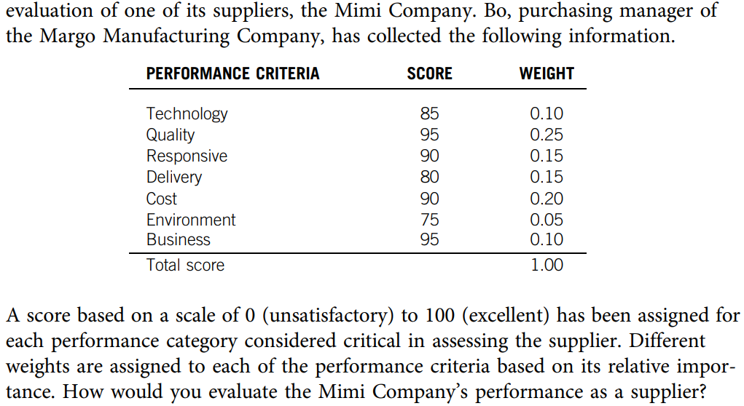
Practice Question

